Slide 1
Revelation
Chapter 1:1-8

Slide 2
Verse 1
“The Revelation of Jesus Christ, which God gave Him to show His servants—things which must shortly take place. And He sent and signified it by His angel to His servant John”
“REVELATION”
(Gk. apokalupsis)
  “to uncover”
  given by God to Jesus to John (a dispensation, cf. Eph. 3:1-5, NKJV)
  John was essentially a “mailman”

Slide 3
Verse 1
“The Revelation of Jesus Christ, which God gave Him to show His servants—things which must shortly take place. And He sent and signified it by His angel to His servant John”
“things which must shortly take place” (cf. “time is near” v. 3)
From the outset John destroys the popular “Futurist Interpretation”

Slide 4
Futurists
contends that majority of book is yet to be fulfilled
  makes verse 1, 3, etc. nonsensical
  how would “Revelation” help those Christians if majority of book was to be fulfilled thousands of years later?

Slide 5
Futurists
Hal Lindsey interprets the fourth bowl to be an atmosphere that is radically upset by a full scale nuclear exchange.
(Lindsey, Hal. There’s A New World Coming. New York: Bantam Books, p. 208. 1975.)
How is that going to help Christians of the first century to “remain faithful?”

Slide 6
What Does “Shortly Come To Pass” Mean?
Doesn’t convey a passing of thousands of years!
1 Timothy 3:14, “These things I write to you, though I hope to come to you shortly”
Notes:
It means what it “says” (Mk. 1:15; 9:1; Matt. 24:32-34)

Slide 7
Verse 1
“The Revelation of Jesus Christ, which God gave Him to show His servants—things which must shortly take place. And He sent and signified it by His angel to His servant John”
“Signified”
  Greek, “semaino” means to give a sign (Strong’s)
  Revelation is a book of “signs”
  Many neglect this word when interpreting the book!

Slide 8
Verse 2
“who bore witness to the word of God, and to the testimony of Jesus Christ, to all things that he saw.”
John bore witness
  eye witness, “things that he saw”
  “witness” many of the Lord’s witnesses were delivered to death (2 Cor. 4:7-12)
  Of the noun (μάρτυς, martus)
    “those who after his example have proved the strength and genuineness of their faith in Christ by undergoing a violent death” (Online Bible Greek Lexicon)
Notes:
“Martus” is found in Rev. 2:13.

Slide 9
Verse 2
“who bore witness to the word of God, and to the testimony of Jesus Christ, to all things that he saw.”
“word of God” and “testimony of Jesus Christ”
Some try to make a superficial distinction between these two phrases (ex., Seventh-Day Adventist)
The testimony of Jesus is simply a part of the word of God

Slide 10
Verse 3
“Blessed is he who reads and those who hear the words of this prophecy, and keep those things which are written in it; for the time is near.”
Revelation describes
“The Blessed Man”
  One of the living lessons of the living word of God
  Must read, hear and keep it
  Seven times the “Blessed Man” is described in Revelation (cf. 14:13; 16:15; 19:9; 20:6; 22:7; 22:14)
Notes:
These Christians were under persecution, yet could be blessed if they read, hear and keep the things written in this book.

Slide 11
Verse 4
“John, to the seven churches which are in Asia: Grace to you and peace from Him who is and who was and who is to come, and from the seven Spirits who are before His throne”
John the Apostle
  Brother was James (Sons of Zebedee)
  Jesus labeled “Boanerges” (“sons of thunder,” Mk. 3:17)
  Would drink from the same cup of suffering as Jesus did (Mk. 10:35ff)
    James was the first to die (Acts 12:1, 2)
    John was the last

Slide 12
Verse 4
“John, to the seven churches which are in Asia: Grace to you and peace from Him who is and who was and who is to come, and from the seven Spirits who are before His throne”
Western Turkey
There were other churches in Asia besides these seven
  Troas (Acts 20:5)
  Hierapolis (Col. 4:13)
  Colossae (Col. 1:2)
“Seven” is John’s favorite number in Revelation and therefore signifies “all churches”

Slide 13
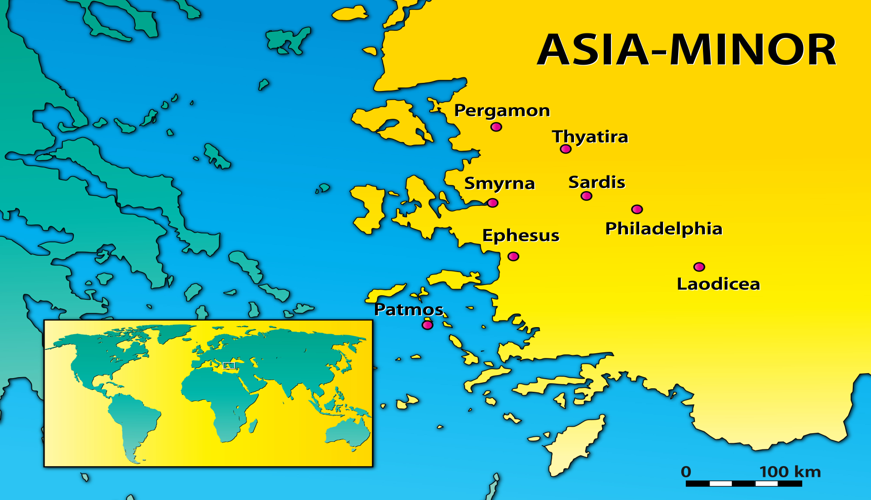
Seven Churches of Asia
(http://dwellingintheword.wordpress.com/2014/07/29/1367-revelation-2/)

Slide 14
Verse 4
“John, to the seven churches which are in Asia: Grace to you and peace from Him who is and who was and who is to come, and from the seven Spirits who are before His throne”
John references the three persons of the Godhead
  The Father

Slide 15
Verse 4
“John, to the seven churches which are in Asia: Grace to you and peace from Him who is and who was and who is to come, and from the seven Spirits who are before His throne”
John references the three persons of the Godhead
  The Father
  The Holy Spirit
  “The number seven is used again to describe the perfection of the Holy Spirit, who Jesus called ‘the Spirit of truth,’ ‘the Comforter,’ who would reveal all truth (John 15:26; 16:13).” (Harkrider, Robert, “Revelation” Truth Commentary)

Slide 16
Verse 5
“and from Jesus Christ, the faithful witness, the firstborn from the dead, and the ruler over the kings of the earth. To Him who loved us and washed us from our sins in His own blood”
John references the three persons of the Godhead
  The Father
  The Holy Spirit
  The Son

Slide 17
Verse 5
“and from Jesus Christ, the faithful witness, the firstborn from the dead, and the ruler over the kings of the earth. To Him who loved us and washed us from our sins in His own blood”
The Lord’s Three Part Work
faithful witness/faithfully declared that he had seen God and was God (Jn. 1:18)
KING
PRIEST
PROPHET
“ruler over the kings” (Ps. 89:27; Rev. 19:16)
JESUS
“firstborn from the dead” gives him preeminence and was critical in his priesthood (Heb. 9:23-28)
Notes:
1) “Faithful witness” Jesus is faithful and he is a witness (Gk. martus). Jesus is a faithful witness because He faithfully declared what He saw even unto death. He saw God, was with God, and declared God (Jn. 1:18).
2) “Firstborn from the dead” There were others who were resurrected from the dead, but this phrase denotes more than just being resurrected. Jesus was resurrected to die no more! Compare 1 Corinthians 15:20; Acts 13:34; Rom. 6:9. Through such a work, He destroyed the power of the devil (Heb. 2:14, 15). It also denotes His priority and preeminence among others (Col. 1:18). It was the critical part of his priestly service (Heb. 9:23-28; 10:19-22)
3) “Ruler over the kings of the earth”
Ethan spoke in Psalm 89, “Also I will make him My firstborn, the highest of the kings of the earth” (v. 27). He is King of kings and Lord of lords (Rev. 19:16). No doubt that this thought would have comforted the disciples and reassured them that Jesus is really in control of it all (cf. 1 Pet. 3:22).
The fact that Christ’s kingdom survived Rome’s kingdom shows that He really does rule over men and is King even of the mighty kings of history.

Slide 18
Verse 5
“and from Jesus Christ, the faithful witness, the firstborn from the dead, and the ruler over the kings of the earth. To Him who loved us and washed us from our sins in His own blood”
Premillennialists miss the point on the rejection of Christ!
  Jesus’ rejection and death to secure the remission of sins!
  Foreknown—His kingdom is preceded by rejection (cf. Lk. 17:20-25; Rev. 13:8)
  Had the power to not die (Jn. 10:17, 18)
    A willful sacrifice to become our high priest

Slide 19
Verse 5
“and from Jesus Christ, the faithful witness, the firstborn from the dead, and the ruler over the kings of the earth. To Him who loved us and washed us from our sins in His own blood”
“Loved” and “Washed” is
“In His own blood”
if no blood, no washing!
the blood of Christ washes the sinner’s soul in baptism
  “And now why are you waiting? Arise and be baptized, and wash away your sins, calling on the name of the Lord” (cf. Acts 2:38; Rom. 6:3-4).
Notes:
a) Until the blood is applied, there is no washing and love of Christ that is real.
b) There are several good people today, but the scripture confines all to have sinned (Rom. 3:23). You may have lied but you don’t lie anymore. You may have drunk alcohol but you don’t drink anymore. You may have thought evil thoughts but you do all you can to not think them anymore.
c) Such is required, but the liar who quits lying is not going to heaven simply because he quit. He may stop practicing the sin, but the sin that he once practiced has left a stain on his soul.
d) The blood of Christ washes away the sin and the stain in baptism (Acts 22:16). Therefore the love of Christ, and the cleansing of the soul is begun at baptism and is not perfected before.
“And now why are you waiting? Arise and be baptized, and wash away your sins, calling on the name of the Lord” (cf. Acts 2:38; Rom. 6:3-4).

Slide 20
Verse 6
“and has made us kings and priests to His God and Father, to Him be glory and dominion forever and ever. Amen.”
KINGS and PRIESTS
  Cleansed to be kings and priests
  Kings sitting in heavenly places “in Christ” (Eph. 2:6)
Notes:
The American Standard Version translates this, “and he made us to be a kingdom, to be priests unto his God and Father…” This follows the royal priesthood spoken of by Peter (1 Pet. 2:9). How many Christians think of themselves as priests? Under the Law of Moses, there was a special class of people ordained as priests. But even then, everyone in the kingdom was to be considered, in one sense, a priest (see. Ex. 19:6). Today, the Roman Catholic Church has a certain clergy who are ordained to a special priesthood. But where does the New Testament teach such? When God chose the Aaronic priesthood, he was very specific that it was through Aaron and no other. But where does God specify a special anointed class within God’s kingdom to serve as priests today?

Slide 21
Verse 7
“Behold, He is coming with clouds, and every eye will see Him, even they who pierced Him. And all the tribes of the earth will mourn because of Him. Even so, Amen.”
Jesus will come again (Acts 1:9-11; 1 Thess. 4:16, 17)

Slide 22
Verse 7
“Behold, He is coming with clouds, and every eye will see Him, even they who pierced Him. And all the tribes of the earth will mourn because of Him. Even so, Amen.”
Jesus will come again (Acts 1:9-11; 1 Thess. 4:16, 17)
Judgment will be universal (Rom. 14:10-12)
  Not a secretive (rapture)
  A visible coming

Slide 23
Verse 7
“Behold, He is coming with clouds, and every eye will see Him, even they who pierced Him. And all the tribes of the earth will mourn because of Him. Even so, Amen.”
Jesus will come again (Acts 1:9-11; 1 Thess. 4:16, 17)
Judgment will be universal (Rom. 14:10-12)
Even the infidels who killed him (Jn. 5:28, 29)
Notes:
Though those infidels crucified the Lord, and though they have died, even they who pierced Him will see Him again. This implies that even though the wicked die, they will live again.

Slide 24
Verse 7
“Behold, He is coming with clouds, and every eye will see Him, even they who pierced Him. And all the tribes of the earth will mourn because of Him. Even so, Amen.”
Jesus will come again (Acts 1:9-11; 1 Thess. 4:16, 17)
Judgment will be universal (Rom. 14:10-12)
Even the infidels who killed him (Jn. 5:28, 29)
All nations will be gathered (Matt. 25:32)
Notes:
“All the tribes—peoples—will mourn when he comes because of their sins and the knowledge that their condemnation is a certainty. . .”[i]
[i] Hinds, John T. A Commentary on the Book of Revelation. Nashville, Tenn.: Gospel Advocate, p. 23. 1989.

Slide 25
Verse 7
“Behold, He is coming with clouds, and every eye will see Him, even they who pierced Him. And all the tribes of the earth will mourn because of Him. Even so, Amen.”
Jesus will come again (Acts 1:9-11; 1 Thess. 4:16, 17)
Judgment will be universal (Rom. 14:10-12)
Even the infidels who killed him
(Jn. 5:28, 29)
All nations will be gathered (Matt. 25:32)
A double “Amen”

Slide 26
Verse 8
“ ‘I am the Alpha and the Omega, the Beginning and the End,’ says the Lord, ‘who is and who was and who is to come, the Almighty.’”
Everlasting God
  “Alpha” and “Omega” –the beginning and the end of the Greek alphabet
  Our savior is the beginning and the end and all that is between
  True of the Father and Son
Notes:
"But you, Bethlehem Ephrathah, Though you are little among the thousands of Judah, Yet out of you shall come forth to Me The One to be Ruler in Israel, Whose goings forth are from of old, From everlasting.“ Micah 5:2/ see Rev. 1:17

